Slide 1
Notes

Slide 2
map()
flatmap()
One to N Transformations
Does more than just transformation. Subscribes to Flux or Mono that’s part of the transformation and then flattens it and sends it downstream
Used for asynchronous transformations
Use it with transformations that returns Publisher
One to One transformation
Does the simple transformation from T to V
Used for simple synchronous transformations
Does not support transformations that returns Publisher

Slide 3
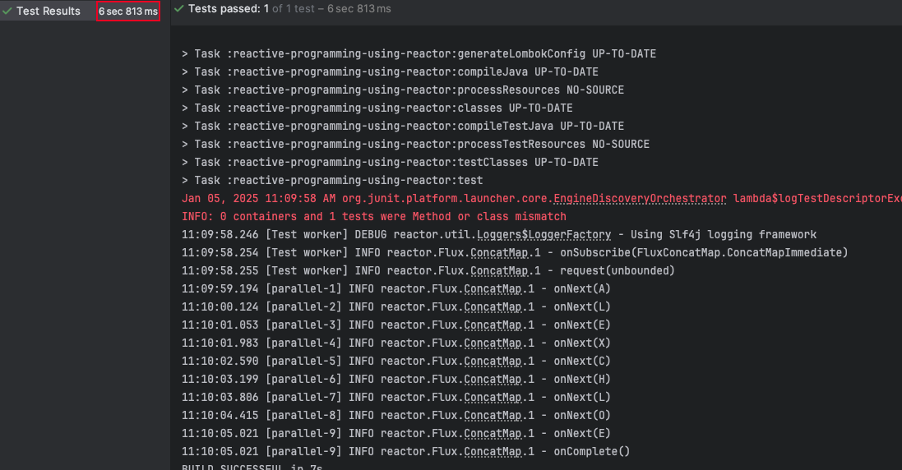
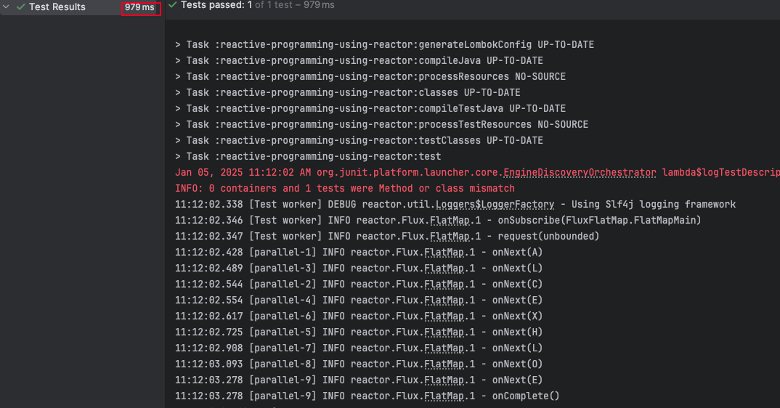
Concatmap()
flatmap()
If the sequence/ orders doesn’t matter
Faster
If the sequence/ orders matter
Slower

Slide 4
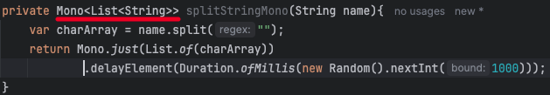
flatMap in Mono
Use it when the transformation returns a Mono
Returns a Mono<T>
Use flatMap if the transformation involves making a REST API call or any kind of functionality that can be done asynchronously.
Example

